Slide 1
CE 395R 5- Data Mining Clustering

Slide 2
Explorer: clustering data
WEKA contains “clusterers” for finding groups of similar instances in a dataset
Implemented schemes are:
k-Means, EM, Cobweb, X-means, FarthestFirst
Clusters can be visualized and compared to “true” clusters (if given)

Slide 3
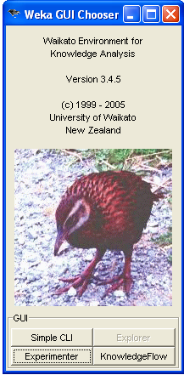
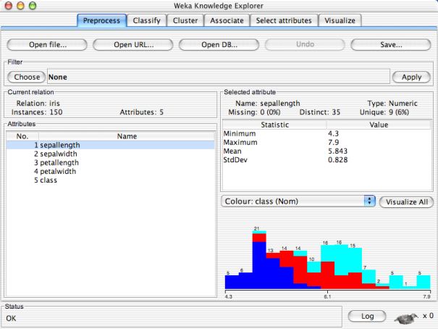

Slide 4
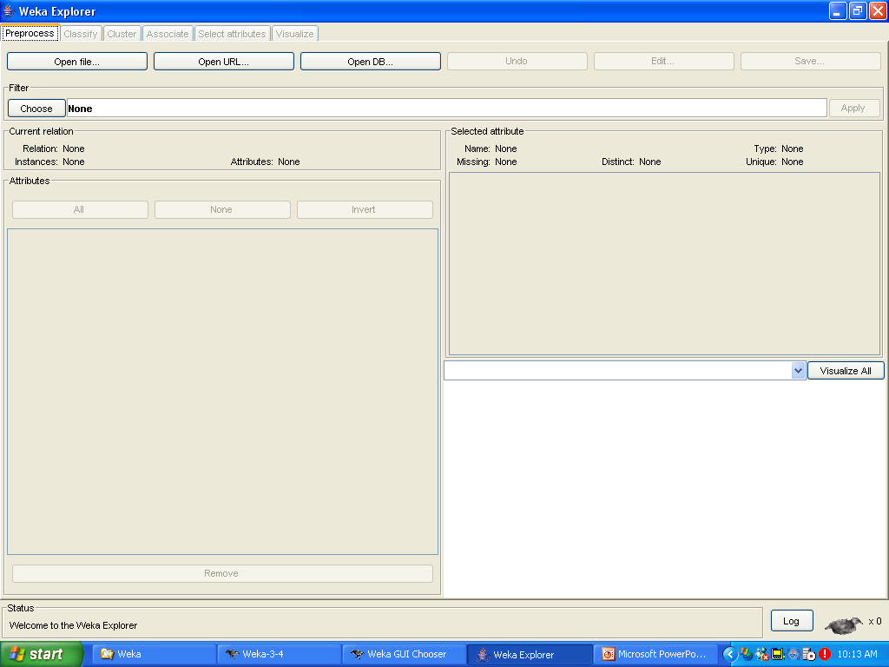

Slide 6
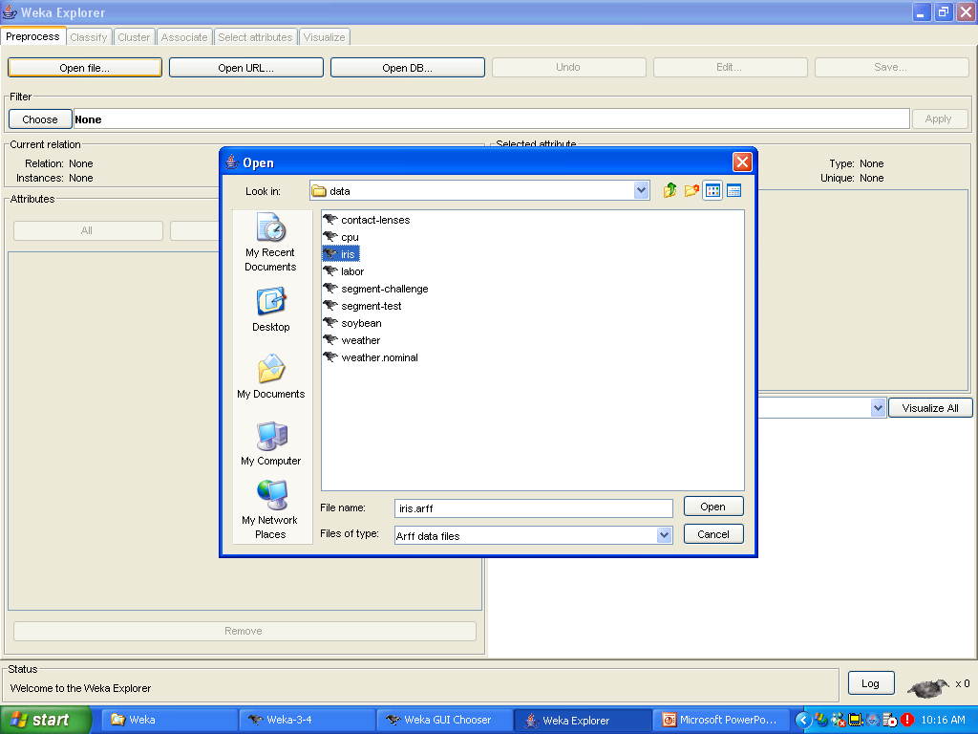

Slide 7
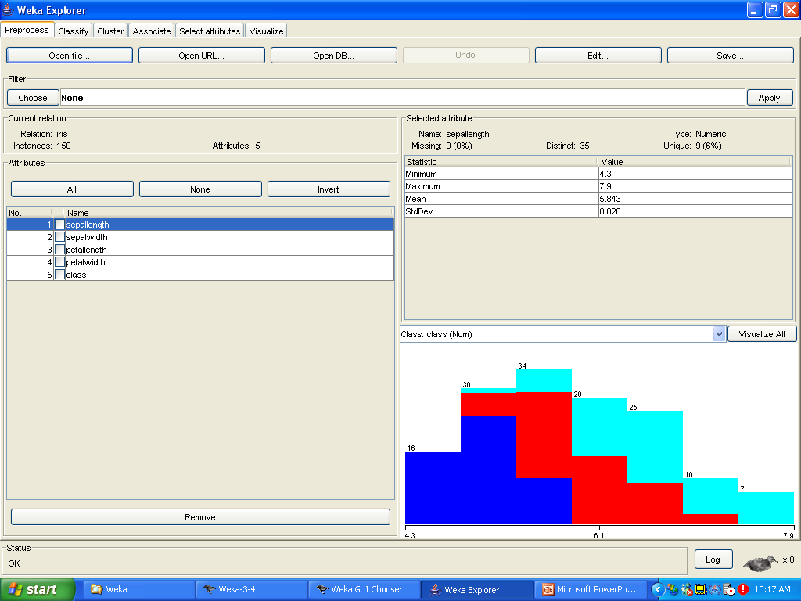

Slide 9
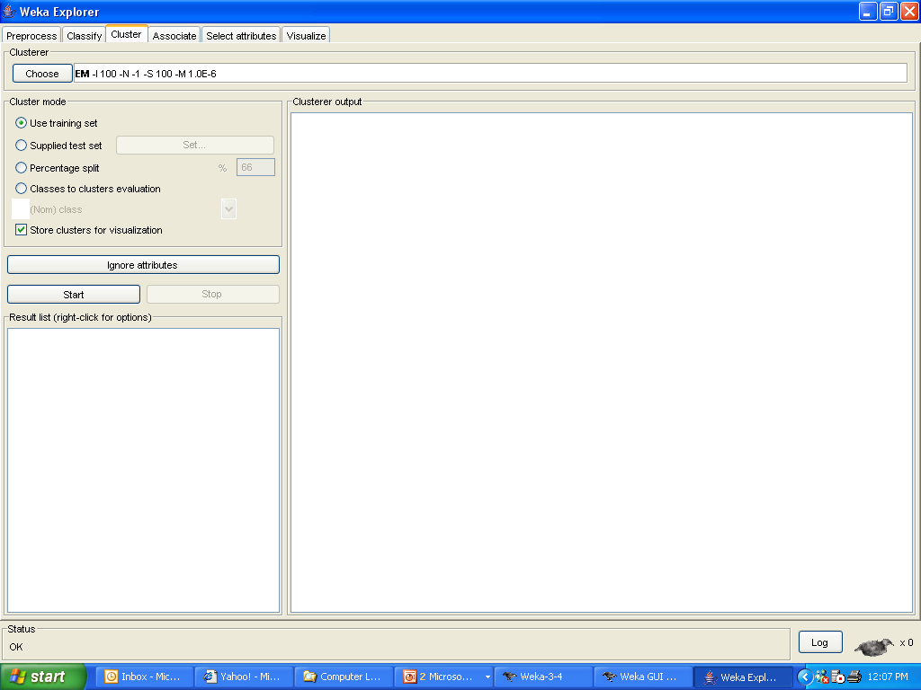

Slide 11
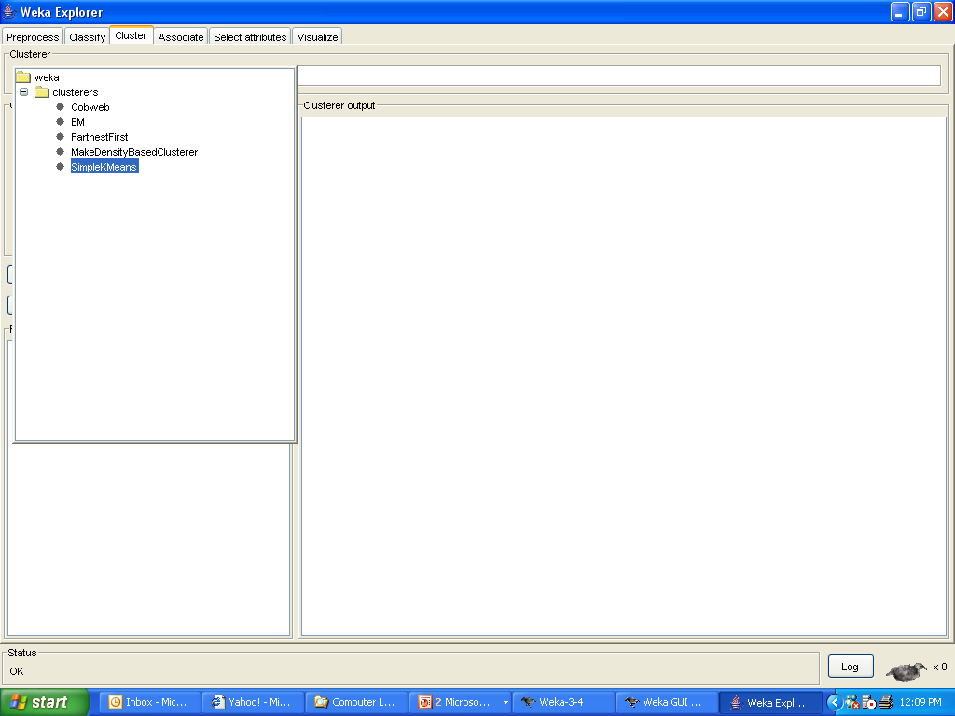

Slide 12
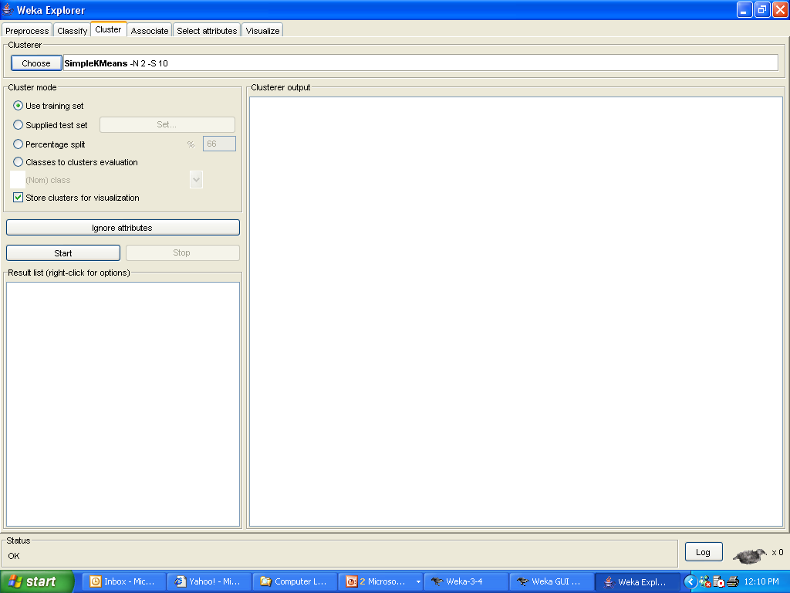
right-click

Slide 13
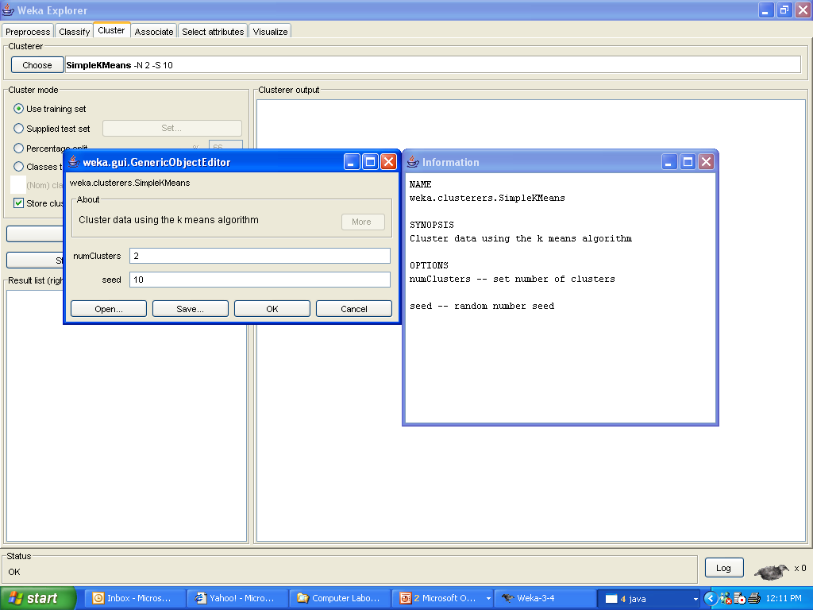

Slide 14
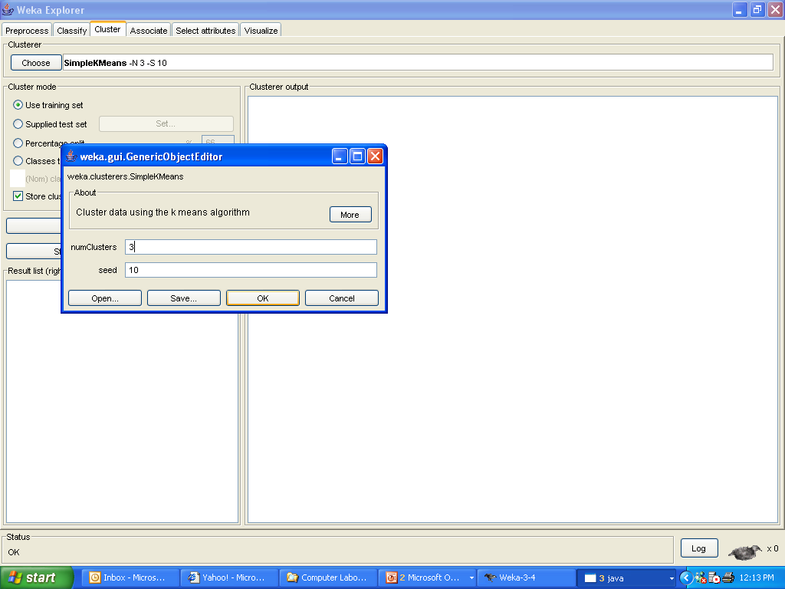

Slide 15
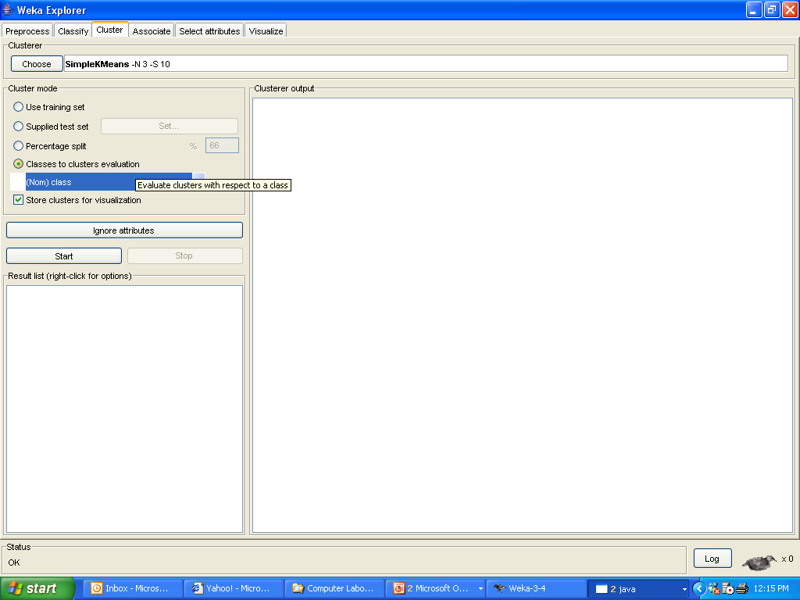

Slide 16
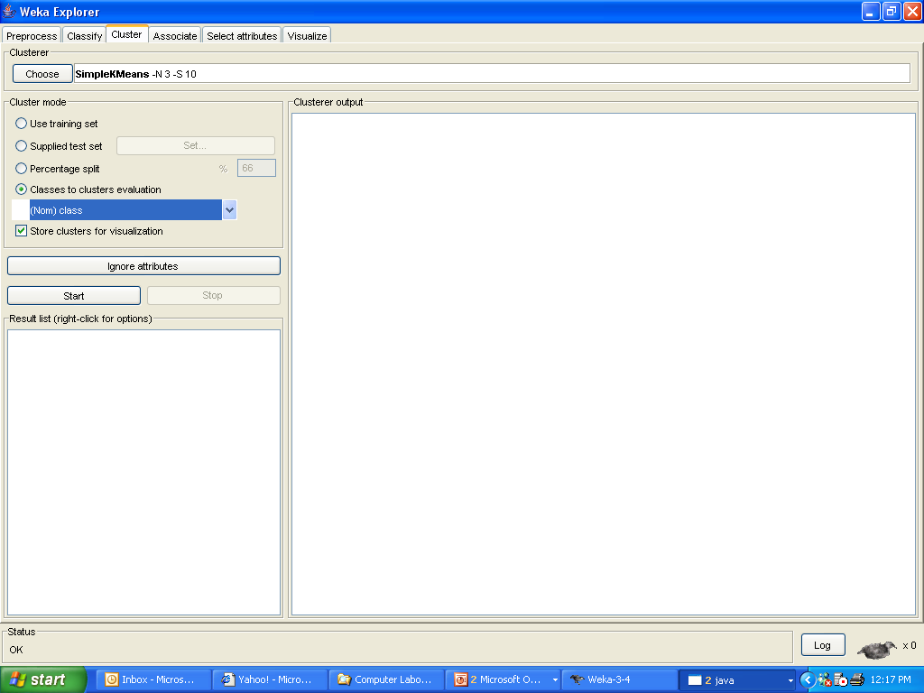

Slide 17
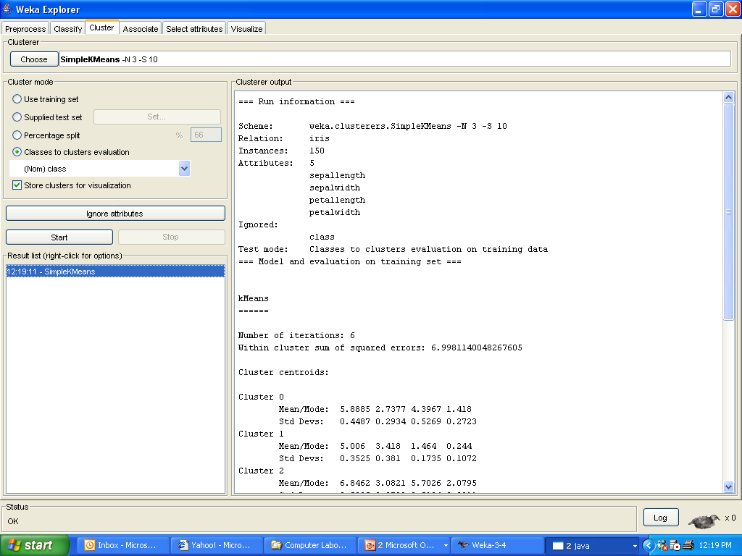

Slide 18
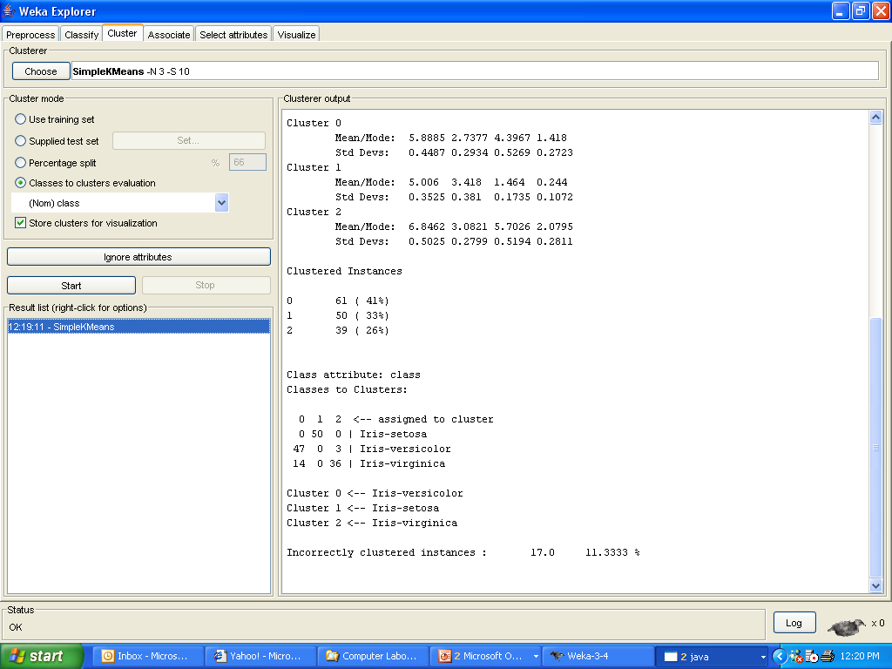

Slide 19
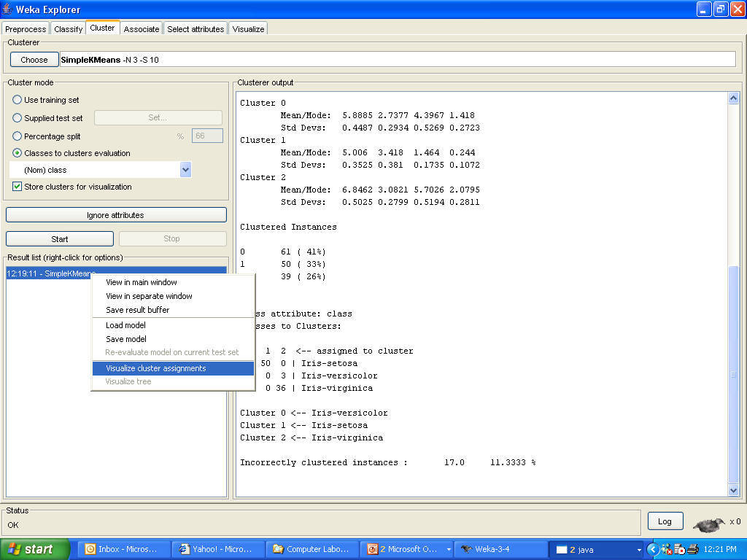
right-click

Slide 20
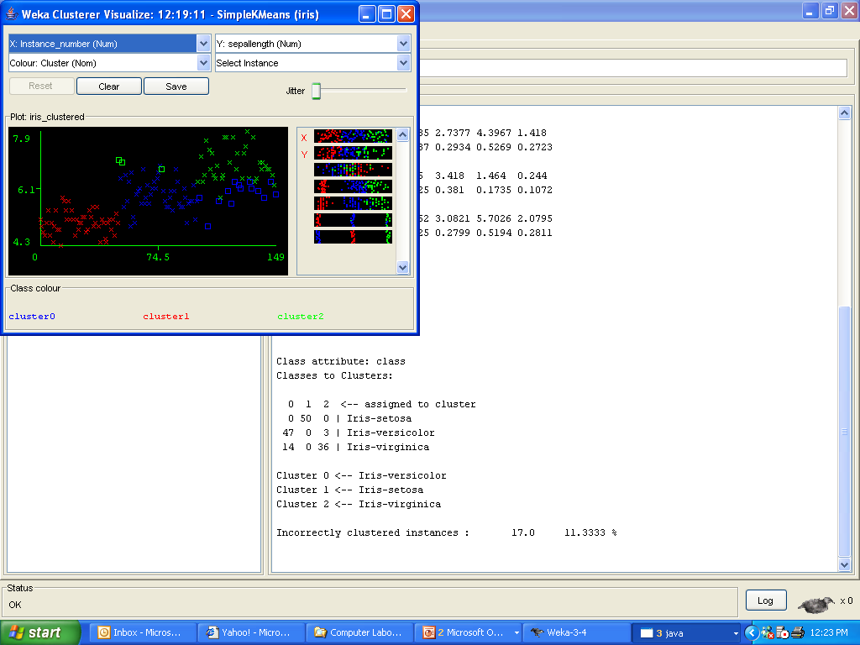

Slide 21
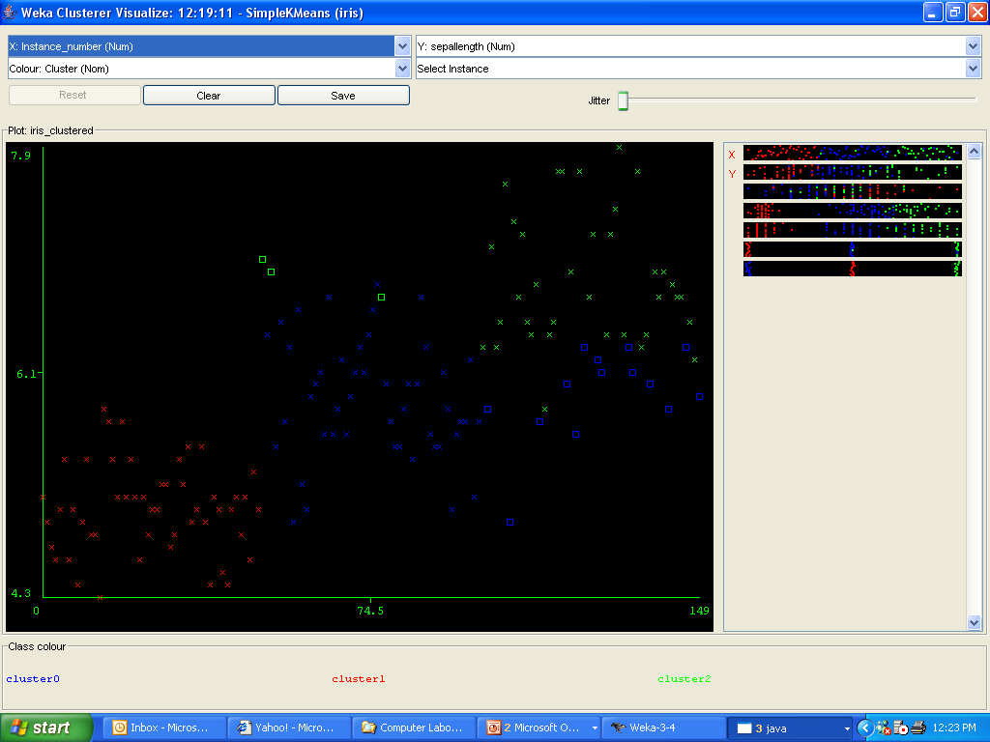

Slide 22
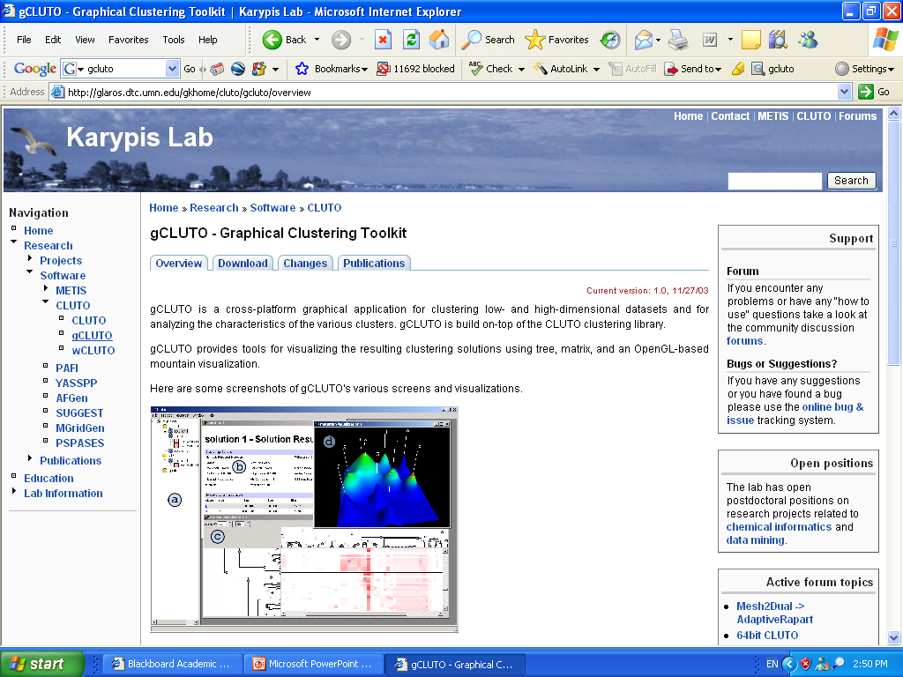
http://glaros.dtc.umn.edu/gkhome/cluto/gcluto/overview

Slide 23
http://glaros.dtc.umn.edu/gkhome/cluto/gcluto/overview

Slide 24
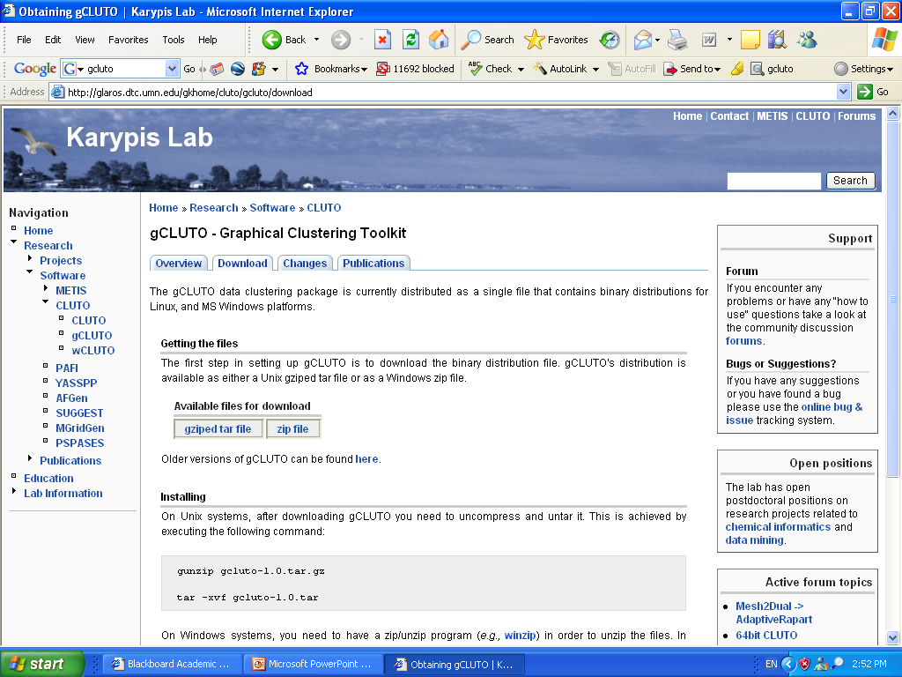

Slide 25
Download and Unzip “gcluto_1_0.zip”

Slide 26
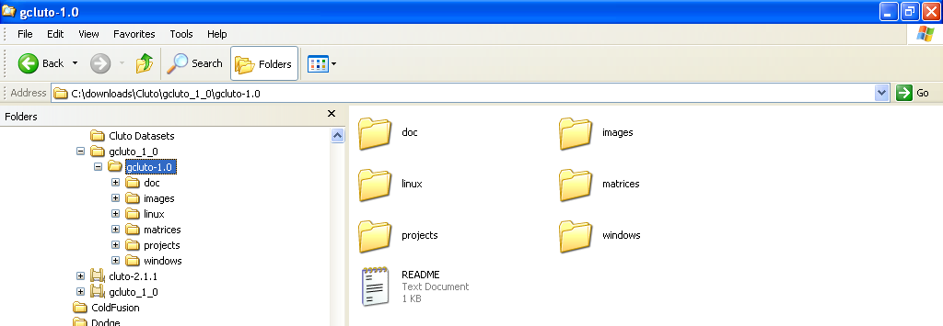
gCLUTO Folders and Files (extracted)

Slide 27
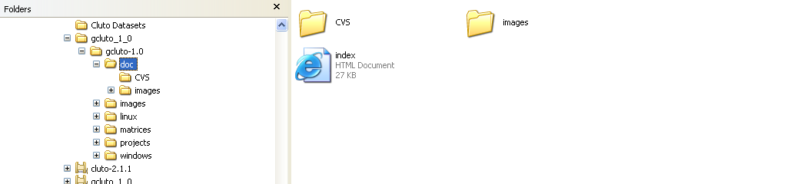
gCLUTO “doc” Subfolder and Files
gCLUTO Documentation

Slide 28
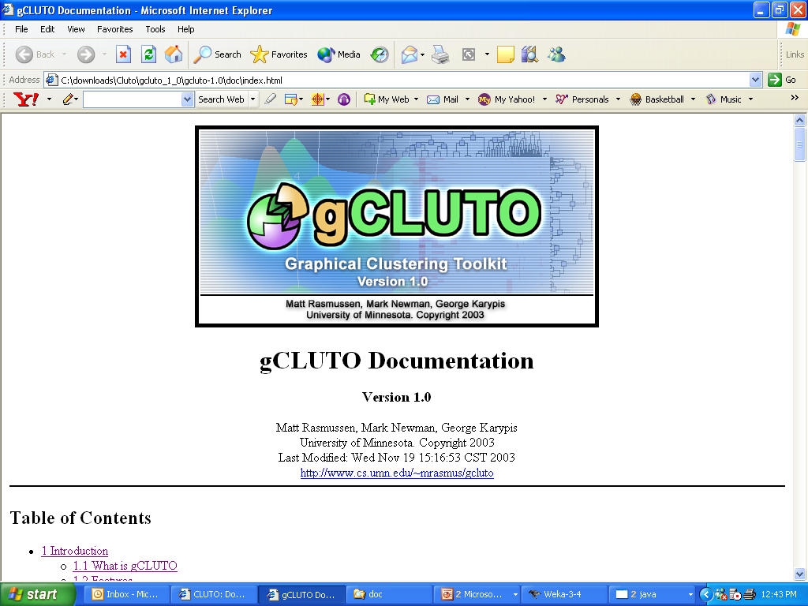

Slide 29
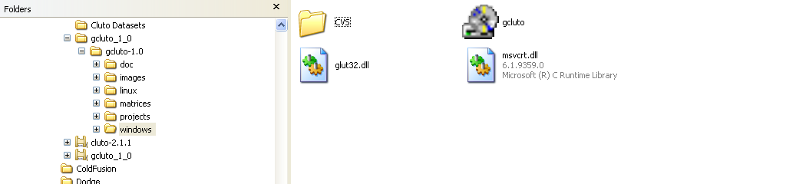
gCLUTO “windows” Subfolder and Files
Executable file;
Double-click to run the program

Slide 30
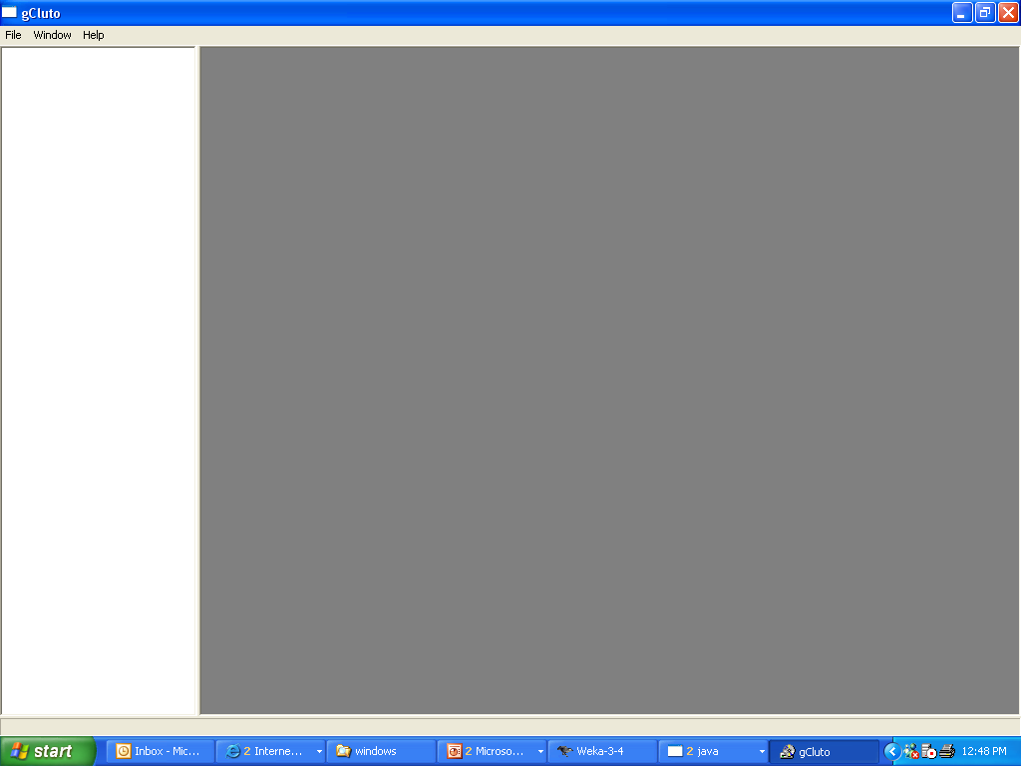

Slide 31
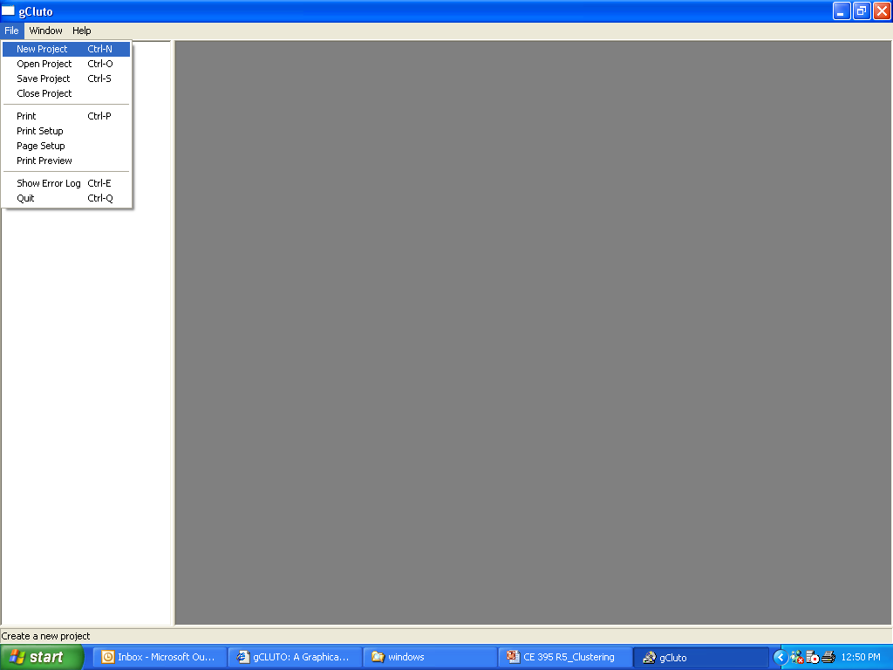

Slide 32
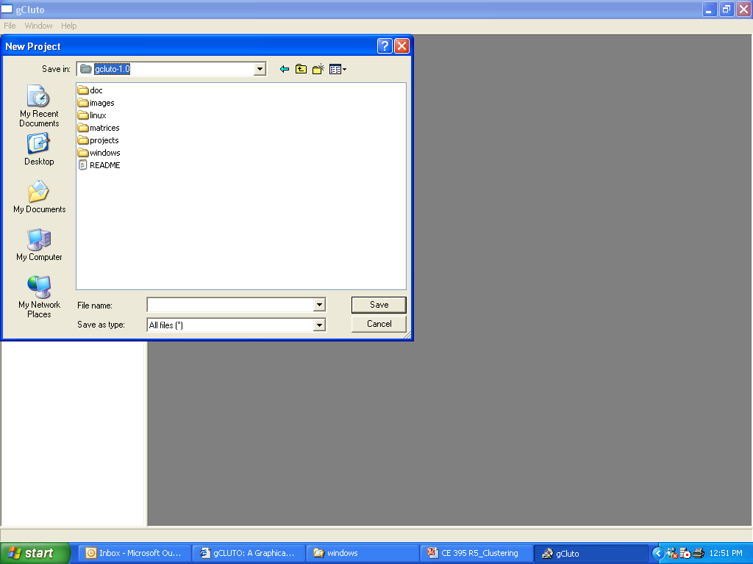
Create a new
“projects” subfolder

Slide 33
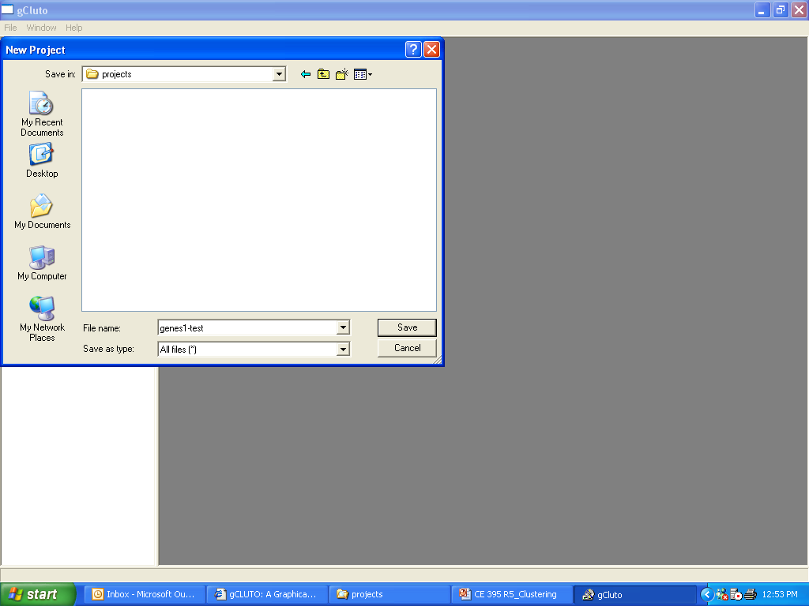

Slide 34
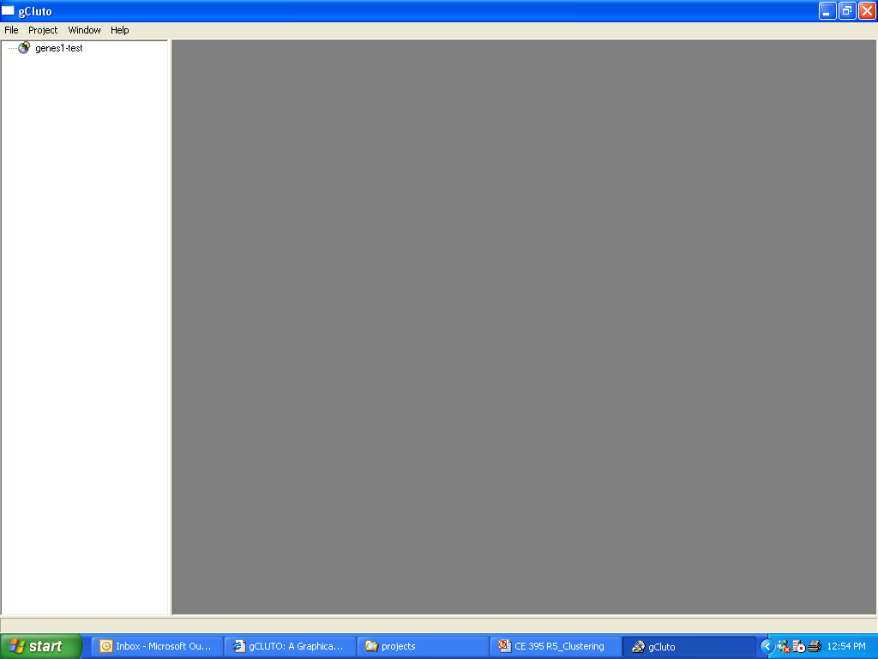

Slide 35
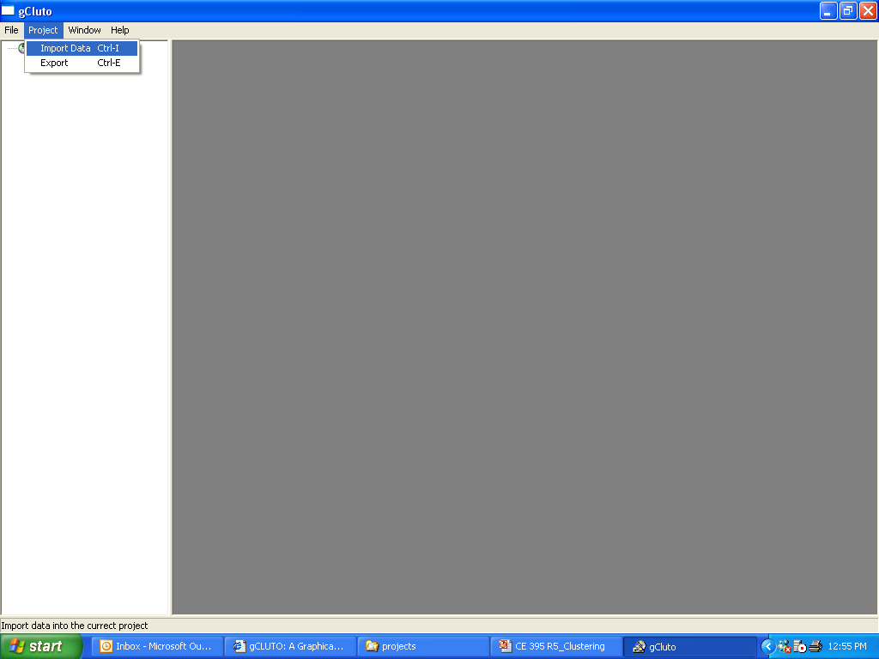

Slide 36
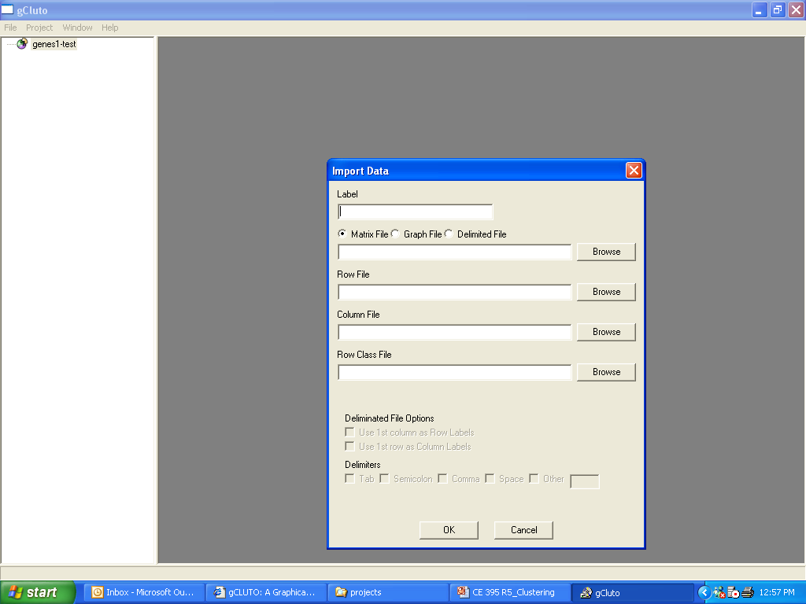

Slide 37
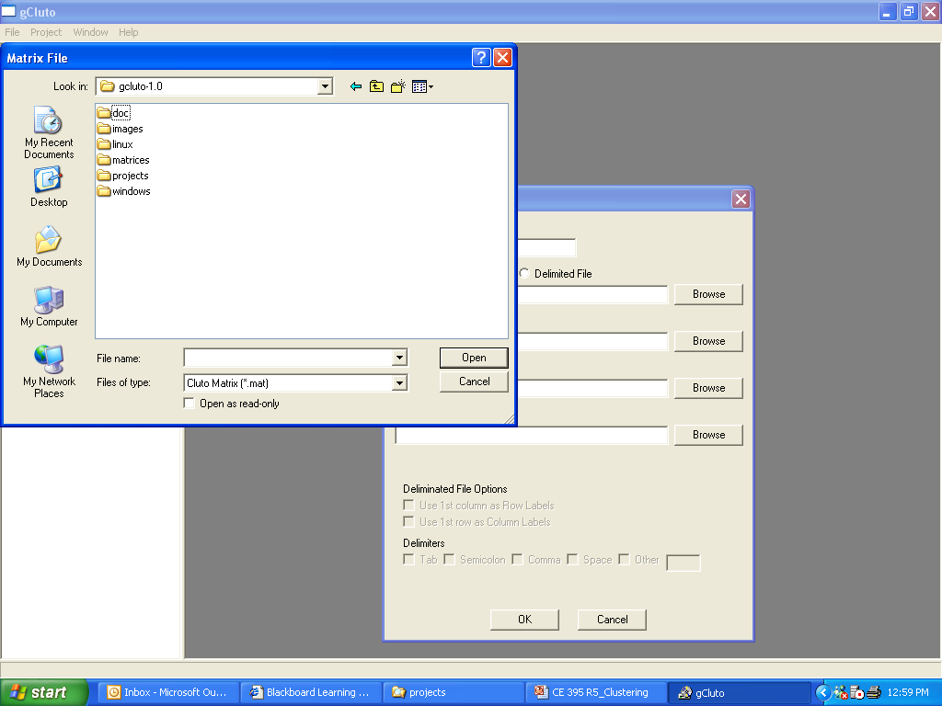
There are a couple of examples
at the “matrices” subfolder

Slide 38


Slide 39
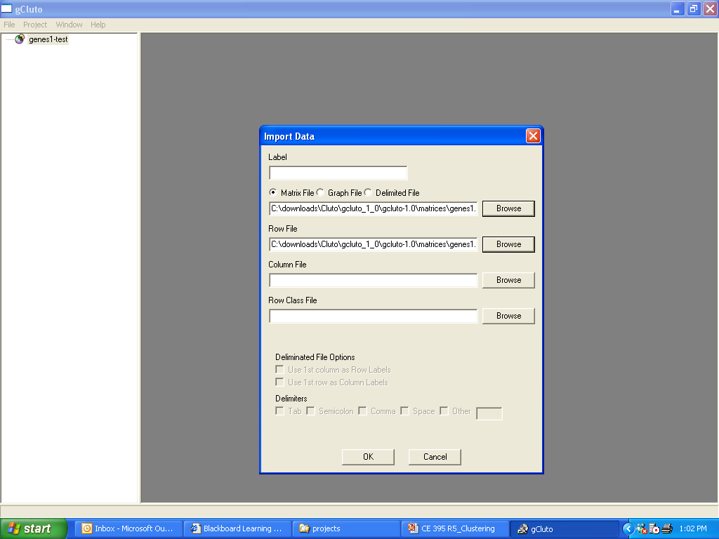

Slide 40
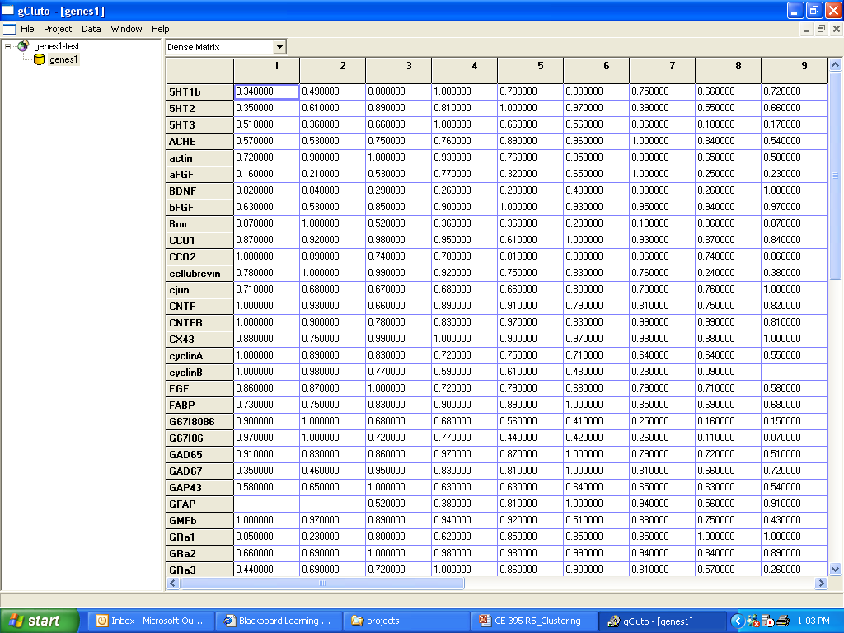

Slide 41
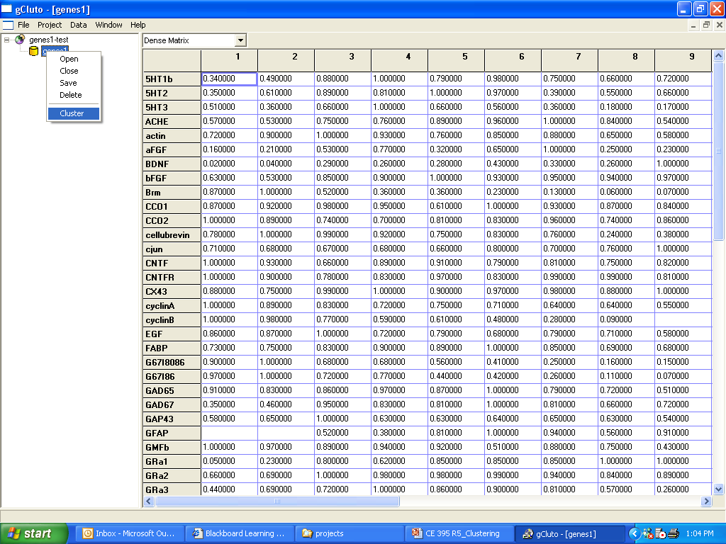

Slide 42
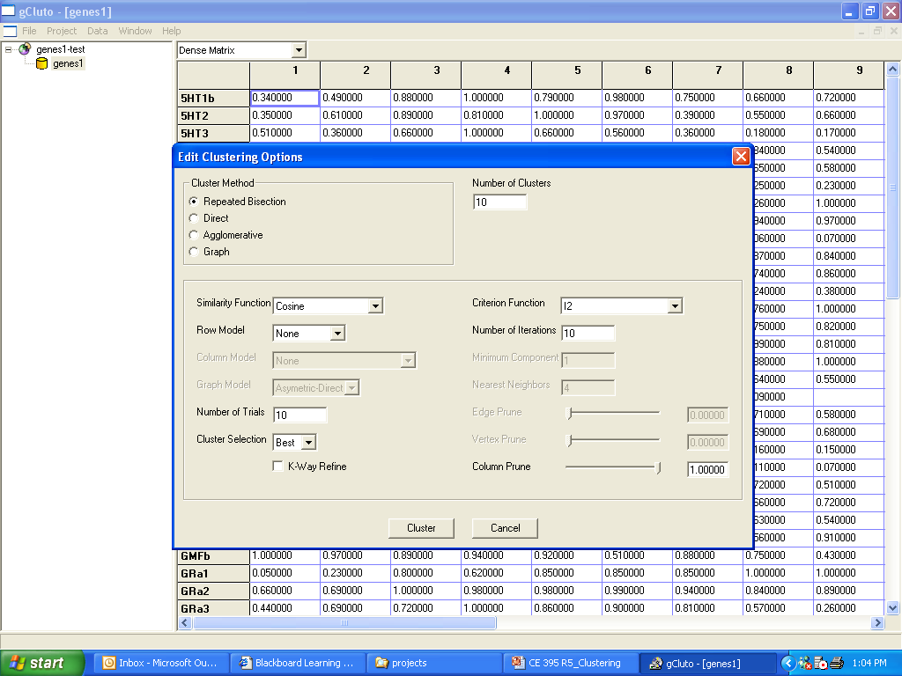

Slide 44
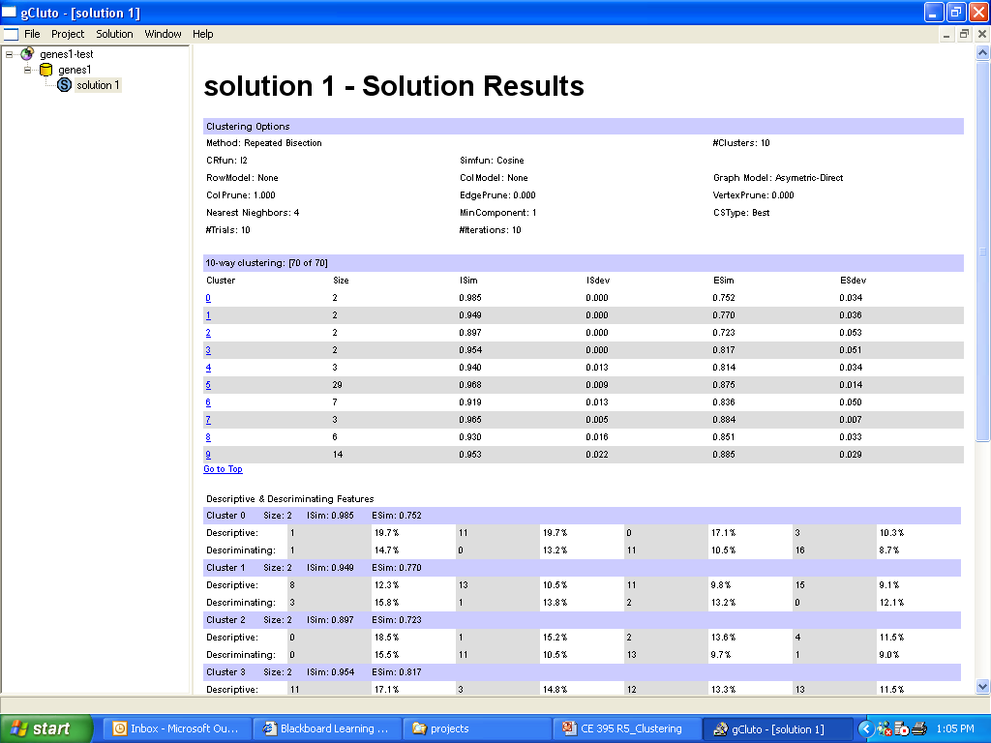

Slide 45
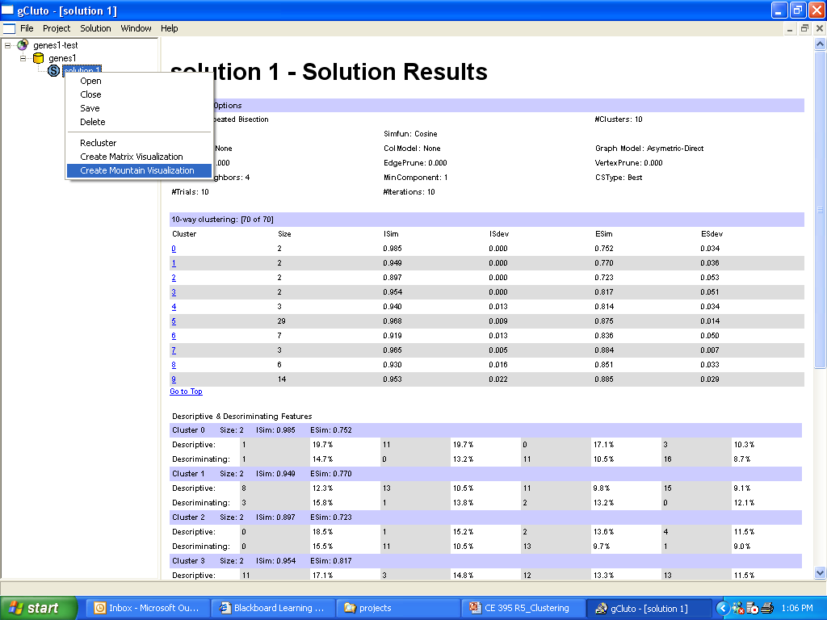

Slide 46
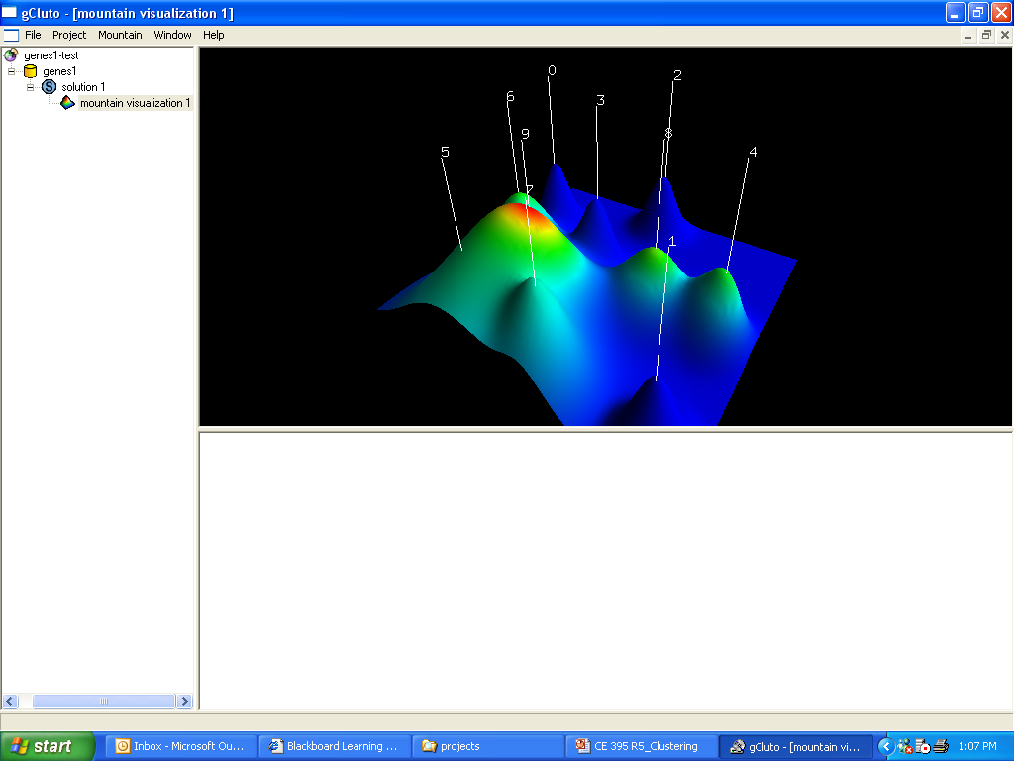

Slide 47
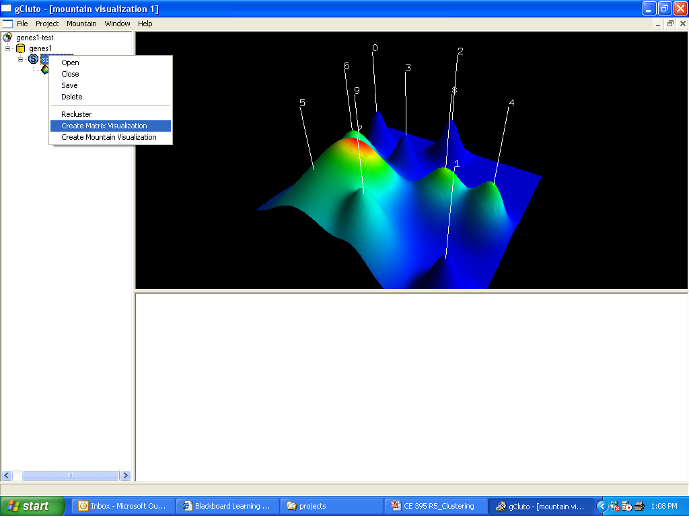

Slide 48
